Slide 1
Admin
Login
Website Management
System
Login
Client
Event info.
Register
User

Slide 2
User Login
Admin Login
1
Login
Admin
---------------
View
Add/Update
User
2
Packages
Admin
Packages
---------------
View
Add/Update
3
Services
Services
---------------
View
Add/Update
4
Cart
Cart
---------------

Slide 3
User
1.1
Provides Login Info
Check Authorize
User
Client
Unauthorized
1.2 Shows Error Message
Authorized
1.3 Redirect to home Page

Slide 4
User
Client
Login
Unauthorized
Redirect to login page
Authorized
Redirect to
Login Page
Book Form
Add To Cart
Display Package
Finalized the form and
process for payment
Continue Viewing
Add Cart
Book
Information
Add Cart Info

Slide 5
User
Select Service
Card Details
Payment = Yes
Payment
Process
Form Process
Payment = No
Payment Done
Redirect To
Home Page

Slide 6

Deshboard
User Login & Register Info
Client Info
Gallery
Admin
Services
Booking Event Info.
User Messages
Feedback & Rating
Approve Feedback & Rating

Slide 7
Home Page
Event Gallery
Event Services
About Us
Client
FeedBack & Rating
Display Feedback & Rating
Contact Page
Login & Register For User
Event Book Form

Slide 8
Start
Event Section
Date & Time
Add Event
Event Gallery
No
Yes
View Events
Images
Search Events
Place Location
Event Information
View Events
Details
View Events
Services
Save
Book Event
form
Edit Events
Yes
Yes
Event Login
Done
Payment Process
Success
Event
Register
Yes
Success Book Event
End

Slide 10
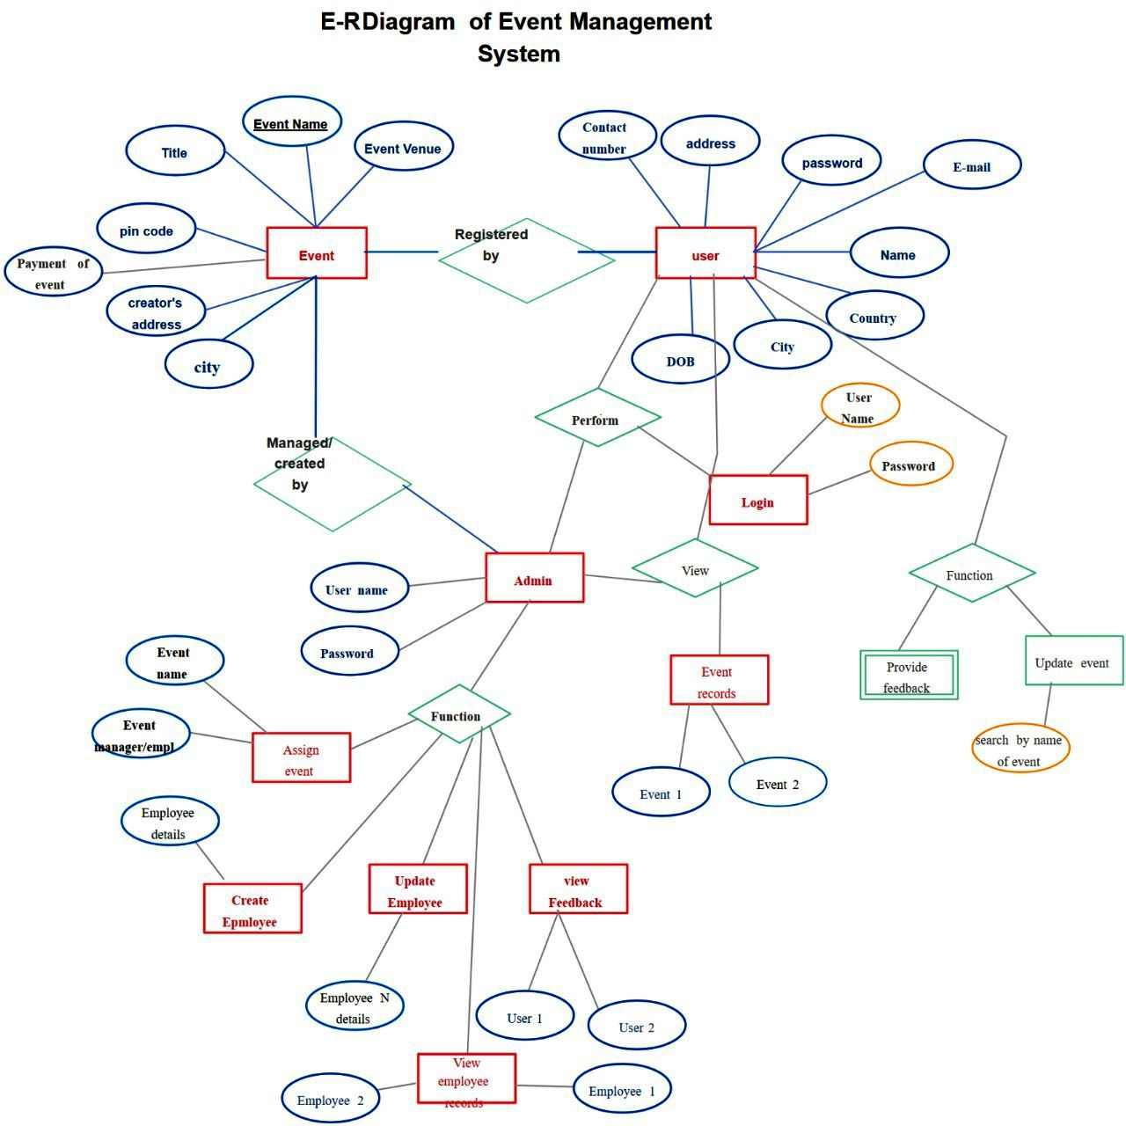



























Event
Name
First Name
Title
Event
Venue
Last Name
Email Id
Contact No.
Address
Event
Registered
By
Country
Payment
of
Event
User
Manager
Details
State
Discount
Area
City
Perform
User
Name
Managed
By
Password
Login
UserName
Admin
View
Function
Event Name
Password
Event
Records
Provide
Feedback
Update
Event
Function
Event Manager
Book Event
Search Event
Event 1
Event 2
Emp. Details
Create Emp
Update Emp
View
Feedback & Reting
Emp 1
User 1
User 2
View
Emp Records
User 3
Emp 2

